Slide 1
The SENSE OF INJUSTICE

Slide 2
Justice?
Aristotle, Plato, Mill, Rousseau, Locke, Marx, Rawls, Scanlon, Raz and many more
Different theories of justice, different forms of justice, . . . The absence of justice; wrong, immoral or unjust decisions Is one society more just than another? Does justice increase over time? . . .

Slide 3
The Sense of Injustice
Much less writing on this topic. O. W. Holmes, Edmund Cahn, Judith Shklar, Barrington Moore.

Slide 4
Even a dog knows the difference between:
Being kicked and
Being stumbled over.
Oliver Wendell Holmes

Slide 5
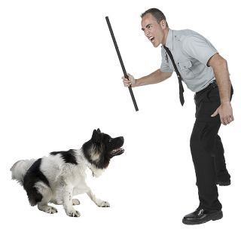
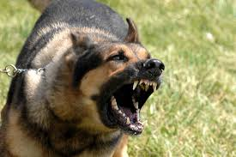

Slide 7
Does the Sense of Injustice change?
Think of the Movie Producer’s Casting Couch

